Slide 1
Functions
CS115
INTRODUCTION TO PROGRAMMING IN PYTHON
WEEK 4

Slide 2
What are Functions
A group of related statements that performs a specific task.
Help divide a program into smaller and modular chunks.
As the size of a program grows, functions make it more organized and manageable.
Using functions minimizes repetition and makes the code reusable.
Functions are not executed in a program until they are “called” or “invoked”
Examples: round(), randint(), len()

Slide 3
Why do we use Functions?
Abstraction:
a process of handling complexity by hiding unnecessary information from the use
Reusability:
the measurement of the likelihood that a given unit of code can be successfully incorporated into another program. Code reuse allows programmers to reuse the same code for similar features in multiple apps, reducing the time it takes to develop new applications.
Modularity:
separating a program's functions into independent pieces or building blocks, each containing all the parts needed to execute a single aspect of the functionality.

Slide 4
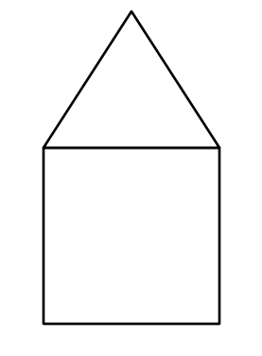
How to draw this shape?
I. Lines between coordinates.
II. Moving pen from a start point.
Drawing regular shapes
(x₂, y₂)
Turn angle x
length-1
(x₃, y₃)
(x₁, y₁)
(x₁, y₁)
length-2
length-3
(x₄, y₄)
(x₅, y₅)

Slide 5
How to draw this shape?
Drawing regular shapes
def draw_house():
draw_rect()
draw_triangle()
def draw_triangle():
______
______
def draw_flat():
draw_rect()
def draw_roof():
draw_triangle()
def draw_rect():
______
______
def draw_house():
draw_flat()
draw_roof()

Slide 6
Reusing code in different places
Functions
def draw_triangle():
______
______
def draw_rect():
______
______
def draw_flat():
draw_rect()
def draw_apartment_5():
draw_flat()
draw_flat()
draw_flat()
draw_flat()
draw_flat()
draw_roof()
def draw_house():
draw_flat()
draw_roof()
def draw_apartment_3():
draw_flat()
draw_flat()
draw_flat()
draw_roof()
def draw_roof():
draw_triangle()

Slide 7
Assume drawings are from ground to upwards
draw_roof()
draw_flat()
draw_house()
draw_apartment_3()
draw_castle()
…
…
draw_flat()
draw_roof()
draw_flat()
draw_flat()
draw_house()
draw_apartment_3()
move to right()
draw_flat()
draw_flat()
draw_roof()
move to right()
draw_apartment_3()
draw_apartment_3()
draw_flat()
draw_flat()
draw_flat()
draw_roof()

Slide 8
FUNCTIONS
draw_apartment_3
draw_apartment_3
draw_apartment_2
draw_apartment_3
draw_apartment_2
draw_house
draw_castle()
draw_castle()
draw_castle_2()
draw_apartment3()
move to right
draw_flat()
draw_flat()
draw_roof()
move to right
draw_apartment_3()
draw_apartment_3()
move to right
draw_apartment_2()
move to right
draw_apartment_3()
draw_apartment_3()
move to right
draw_apartment_2()
move to right
draw_house()
move to right
draw_apartment_2()
move to right
draw_apartment_3()

Slide 9
apartment(x)
apartment_3()
vs
…
apartment_5()
apartment(2)
apartment(5)
apartment(3)

Slide 10
Let’s make it parametric.
Functions
Assume that the drawings are from ground to upwards
draw_apartment(1)
def draw_triangle():
______
______
draw_apartment(2)
def draw_rectangle():
______
______
flat_count
?
def draw_flat():
draw_rect()
def draw_apartment(flat_count):
for i in range(flat_count):
draw_flat()
draw_roof()
def draw_roof():
draw_triangle()
draw_apartment(3)

Slide 11
draw_castle_2()
draw_castle_2()
draw_apartment_3()
move to right
draw_apartment_2()
move to right
draw_house()
move to right
draw_apartment_2()
move to right
draw_apartment_3()
draw_apartment(3)
move to right
draw_apartment(2)
move to right
draw_apartment(1)
move to right
draw_apartment(2)
move to right
draw_apartment(3)
vs
draw_apartment_3()
draw_apartment_2()
draw_house()
draw_apartment()

Slide 12
Abstraction, Reusability, Modularity
draw_triangle() or
draw_roof()
draw_rect()
or
draw_flat()
draw_street_view()
draw_house()
draw_apartment(flat_count)
draw_castle()
draw_church()
‹#›

Slide 13
We can deal with more complex and higher level structures or problems

Slide 14
Defining Functions - Syntax
def keyword marks the start of the function header.
function_name uniquely identifies the function.
formal_parameter_list: (optional) values passed to function, required by the function to do its job.
docstring comment (optional) describes the function and input/outputs.
Indented statements (1 or more) that make up the function body.
return statement (optional) returns calculated values.
def function_name( formal_parameter_list ):
"""
docstring comment
"""
statements
return

Slide 15
Function Example
Write a function that takes two values as parameters and calculates and returns the product of the two numbers.
Inputs: two numbers, n1 and n2
Outputs: product of the numbers, prod.
def multiply_numbers( n1, n2 ):
prod = n1 * n2
return prod
Inputs: formal parameters
Outputs: return value

Slide 16
Calling Functions
Once function is defined, it can be called from the script or from another function.
The function header is a contract that defines the name of the function and the data/parameters required by the function.
product = multiply_numbers( 10, 33 )
Stores the value returned by the function.
actual parameters: values passed to the function.

Slide 17
return Statement
return only has meaning inside a function
Statement can contain an expression that is evaluated, and the value is returned.
If no return statement present, the function returns None, a NoneType object.
Only one return statement can be executed.
When the return statement is executed, function exits and returns to calling location.
Any code in the function after the return statement will not be executed.

Slide 18
One Warning: If NO return STATEMENT
Python returns the value None, if no return given
None is of type NoneValue and represents the absence of a value.
def is_even_one(val):
if val % 2 == 0:
print('number is even')
else:
print('number is odd')
def is_even_two(val):
if val % 2 == 0:
return True
r1 = is_even_one(4)
print('Value: ', r1, 'Type: ', type(r1))
r2 = is_even_two(4)
print('Value: ', r2, 'Type: ', type(r2))
r3 = is_even_two(5)
print('Value: ', r3, 'Type: ', type(r3))
Output:
number is even
Value: None Type: <class 'NoneType'>
Value: True Type: <class 'bool'>
Value: None Type: <class 'NoneType'>

Slide 19
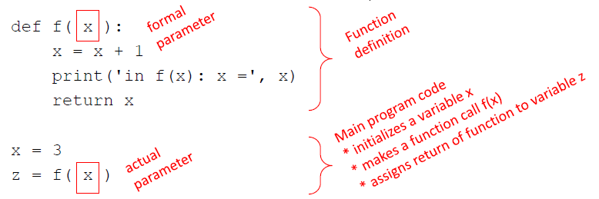
Variable Scope and Functions
The formal parameters will be assigned the values passed in the function call, the actual parameters.
New scope/frame/environment is created when a function is entered.

Slide 20
Visualizing Variable Scope
def f( x ):
x = x + 1
print( 'in f(x): x =', x )
return x
x = 3
z = f( x )
GLOBAL SCOPE
f
x
z
some code
3

Slide 21
Visualizing Variable Scope
def f( x ):
x = x + 1
print( 'in f(x): x =', x )
return x
x = 3
z = f( x )
GLOBAL scope
f
x
z
f scope
x
x
z
some code
3
3

Slide 22
Visualizing Variable Scope
def f( x ):
x = x + 1
print( 'in f(x): x =', x )
return x
x = 3
z = f( x )
GLOBAL scope
f
x
z
f scope
x
x
z
some code
4
3

Slide 23
Visualizing Variable Scope
def f( x ):
x = x + 1
print( 'in f(x): x =', x )
return x
x = 3
z = f( x )
GLOBAL scope
f
x
z
f scope
x
x
z
some code
4
3
Output:
in f(x): x = 4

Slide 24
Visualizing Variable Scope
def f( x ):
x = x + 1
print( 'in f(x): x =', x )
return x
x = 3
z = f( x )
GLOBAL scope
f
x
z
f scope
x
x
z
some code
4
3
Output:
4

Slide 25
Visualizing Variable Scope
def f( x ):
x = x + 1
print( 'in f(x): x =', x )
return x
x = 3
z = f( x )
GLOBAL scope
f
x
z
some code
3
4
Output:
4

Slide 26
Exercises:
Write a function that returns the sum of the digits of a positive integer. Use this function to find the sum of digits of the positive numbers input by the user.
See: 04_exercise1.py
Write a function that takes a number as a parameter and returns the reverse of the number.
See: 04_exercise2.py
Write a function that converts a given string s of a binary number in base 2 to its decimal equivalent and returns the decimal value.
First write a function, named is_binary, that that takes a string parameter and returns True if the parameter string is a binary string with 0s and 1s (e.g., ‘101’), False otherwise (e.g., ‘123’).
Then write a function, named convert_to_decimal, that takes a string parameter and uses your is_binary function to check if the parameter string is a binary number. If it is a binary, then your function converts it to its equivalent decimal. Else it displays an appropriate message to indicate that it is not a valid string for a binary number.
See: 04_exercise3.py

Slide 27
Variable Scope
The scope of a variable is the part of the program from which the variable can be accessed.
Local variables are variables that are defined within a function.
Local variables become available from the point that they are defined in a function until the end of the function in which it they are defined.
Global variables are that are defined outside of functions and have a global scope. Global variables are visible/accessible from inside functions; however, they cannot be directly updated.

Slide 28
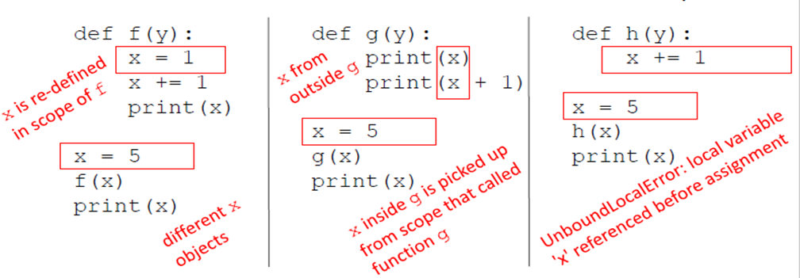
SCOPE EXAMPLE
Inside a function, can access a variable defined outside.
Inside a function, cannot modify a variable defined outside unless you use the global keyword which is not recommended.
Output:
2
5
Output:
5
6
5

Slide 29
Global Variables
Variables that are defined outside of functions.
A global variables are visible from within all functions.
Any function that wants to update a global variable must include a global declaration.
Variables that are assigned values/updated inside functions, with the same name as global variables, are local variables.
If a variable in a function is declared using the global keyword it references the global variable and can be used to access/update the global variable from inside the function.
Warning: Accessing/updating global variables in functions is not generally recommended, as it violates the principle of modularity. Global variables access from within functions can cause unexpected results.

Slide 30
Global Variables - Example
def f():
x = 1
print(x)
x = 5
f()
print(x)
Output:
1
5
def g() :
global x
x = 1
print(x)
x = 5
g()
print(x)
Output:
1
1

Slide 31
Summary – when a function is called:
Actual parameters are evaluated, formal parameters are bound to the values of the actual parameters.
Point of execution (control) moves from the calling statement to the first statement inside the function.
Code in the (indented) body of the function is executed until either:
return statements is reached, and the value following the return statement is returned.
End of the body of the function reached, None is returned.
The point of execution is transferred back to the code following the invocation.

Slide 32
Keyword Arguments
Positional arguments: actual parameters are bound to formal parameters in the order which they are passed. Ex. first formal parameter is bound to the first actual parameter, the second to the second, etc.
Keyword arguments: formal parameters are bound to actual parameters using the name of the formal parameter in the calling statement.
def my_function( v1, v2 ):
#do something...
my_function( 10, 5 )
def my_function( v1, v2 ):
#do something...
my_function( v1 = 10, v2 = 5 )

Slide 33
Keyword Arguments
def printName(firstName, lastName, reverse):
if reverse:
print(lastName + ',' + firstName)
else:
print(firstName, lastName)
printName('Joe', 'Smith', False)
printName('Joe', 'Smith', reverse = False)
printName('Joe', lastName = ‘Smith', reverse = False)
printName(lastName = 'Smith', firstName = 'Joe', reverse = False)
The statements above are equivalent, all call printName with the same actual parameter values.
Keyword arguments can appear in any order
Non-keyword arguments cannot follow a keyword arguments, the following is not allowed.
printName('Joe', lastName='Smith', False)

Slide 34
Default Parameters
Default values indicate that the function argument will take that value if no argument value is passed during the function call.
The default value is assigned by using the assignment(=) operator of the for:
keywordname = value
Parameters without a default value are required.
Parameters with a default value are optional.
You provide preferred, default values for your parameters. You let users of your method change those values for their own needs.

Slide 35
Default Parameters
Keyword arguments can be used together with default parameter values.
def printName(firstName, lastName, reverse = False):
if reverse:
print(lastName + ',' + firstName)
else:
print(firstName, lastName)
The following statements:
printName('Joe', 'Smith')
printName('Joe', 'Smith', True)
printName('Joe', lastName = 'Smith', reverse = True)
Would output, with the last two being semantically equivalent:
Joe Smith
Smith,Joe
Smith,Joe

Slide 36
Functions as Objects
In Python, a function can be assigned to a variable. This assignment does not call the function, instead a reference to that function is created.
my_fun = round # my_fun now references the round function.
Compare this to the statement:
my_fun = round( 3.48 ) # this statement calls or invokes the round function;
# my_fun is assigned the value returned by the function

Slide 37
Higher Order Functions
A function is called Higher Order Function if it contains other functions as a parameter or returns a function as an output.
Properties of higher-order functions:
A function is an instance of the Object type.
You can store the function in a variable.
You can pass the function as a parameter to another function.
You can return the function from a function.
You can store them in data structures such as hash tables, lists, …

Slide 38
A Simple Example – what is the output?
def do_this( num, this ):
return this(num)
val = float(input('Enter a number: '))
# do this - find the ceiling of the value
result = do_this(val, math.ceil)
print(f'Ceiling of {val} is {result}')
# do this - find the int representation of the value
result = do_this(val, int)
print(f'int representation of {val} is {result}')
# do this - find the square root of the value
result = do_this( val, math.sqrt)
print(f'Rounded square root of {val} is {do_this(result,round)}')

Slide 39
A Simple Example – what is the output?
def do_this( num, this ):
return this(num)
val = float(input('Enter a number: '))
# do this - find the ceiling of the value
result = do_this(val, math.ceil)
print(f'Ceiling of {val} is {result}')
# do this - find the int representation of the value
result = do_this(val, int)
print(f'int representation of {val} is {result}')
# do this - find the square root of the value
result = do_this( val, math.sqrt)
print(f'Rounded square root of {val} is {do_this(result,round)}')
Output:
Enter a number: 62.364
Ceiling of 62.364 is 63
int representation of 62.364 is 62
Rounded square root of 62.364 is 8
See: 05_higher_order_functions01.py

Slide 40
A Simple Example – returning functions
def find_function( choice ):
if choice == 1:
return int
elif choice == 2:
return float
else:
return bool
value = input('Enter value: ')
print('Convert value to:')
choice = int( input('\t1 - int\n\t2 - float\n\t3 - bool\nchoice: '))
fcn = find_function( choice )
value = fcn( value )
print(f'Updated value {value} is type {type(value)}')
See: 05_higher_order_functions02.py

Slide 41
Trace the following program and find the output:
def f(x):
def g():
x = 'abc'
print('x = ', x)
def h():
z = x
print('z = ', z)
x = x + 1
print('x = ', x)
h()
g()
print('x = ', x)
return g
x = 3
z = f(x)
print('x = ', x)
print('z = ', z)
z()
Visualization of this code in pythontutor.com

Slide 42
Trace the following program and find the output:
def f(x):
def g():
x = 'abc'
print('x = ', x)
def h():
z = x
print('z = ', z)
x = x + 1
print('x = ', x)
h()
g()
print('x = ', x)
return g
x = 3
z = f(x)
print('x = ', x)
print('z = ', z)
z()
Output:
x = 4
z = 4
x = abc
x = 4
x = 3
z = <function f.<locals>.g at 0x0000027C3EC98400>
x = abc

Slide 43

Terms of Use
This presentation was adapted from lecture materials provided in MIT Introduction to Computer Science and Programming in Python.
Licenced under terms of Creative Commons License.

